Slide 1
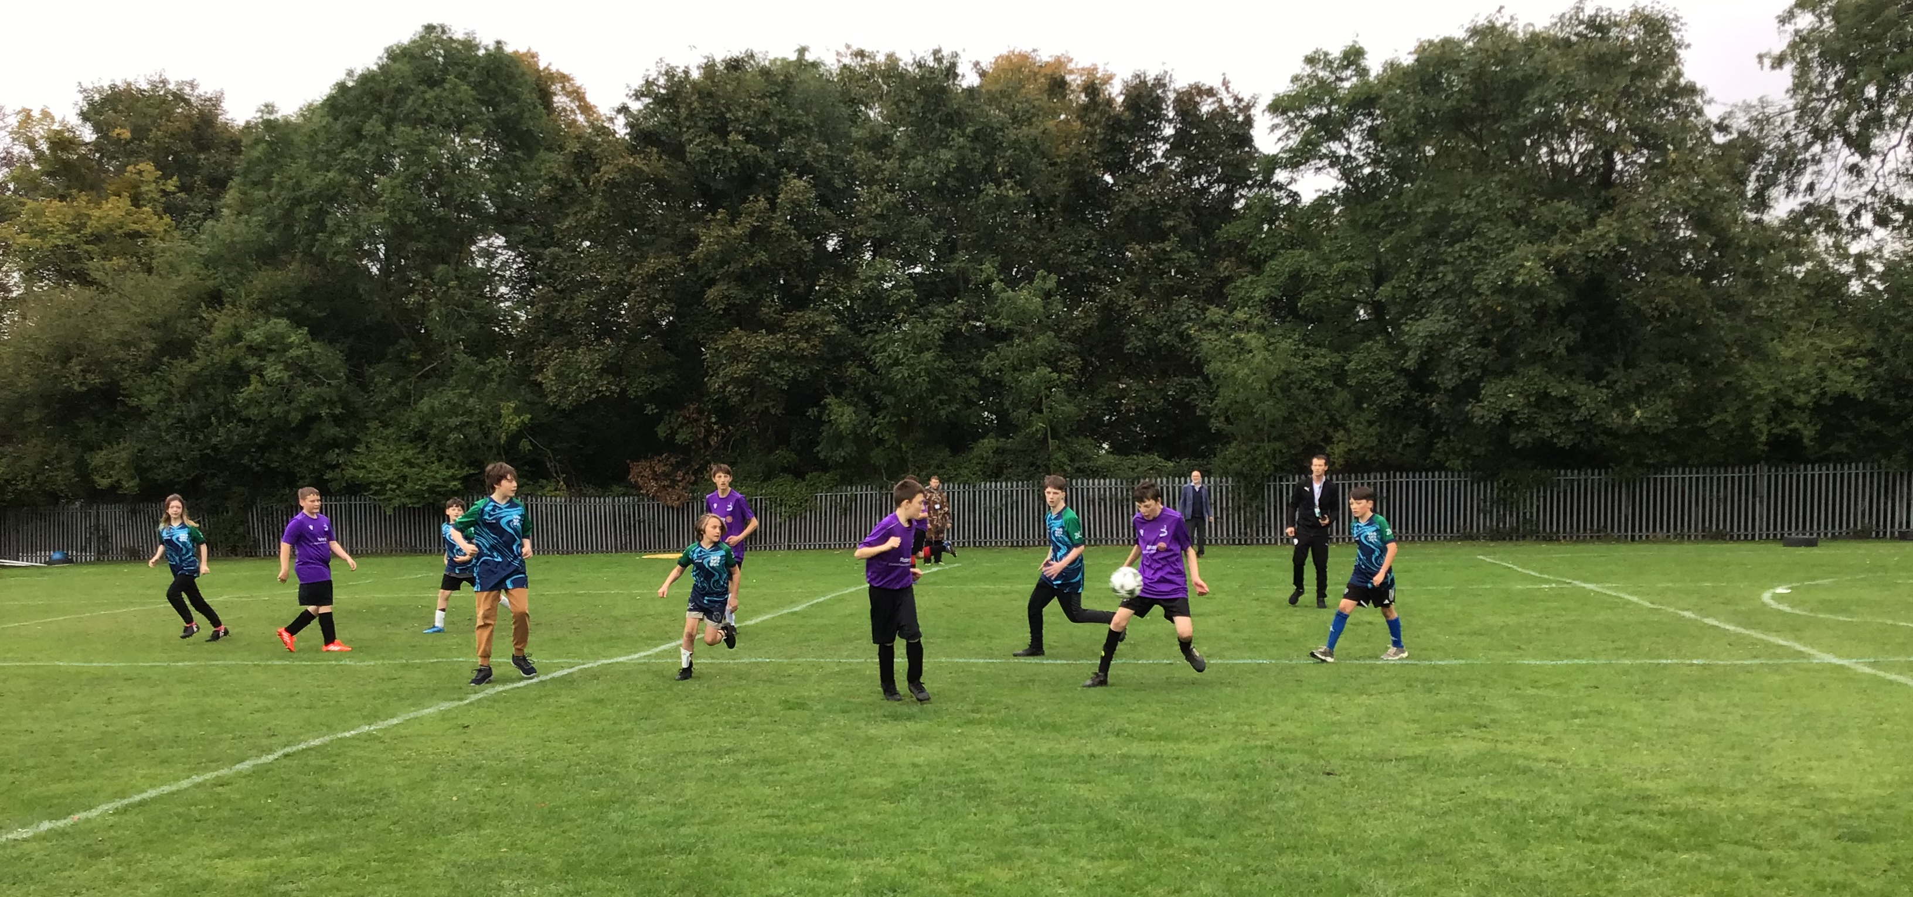
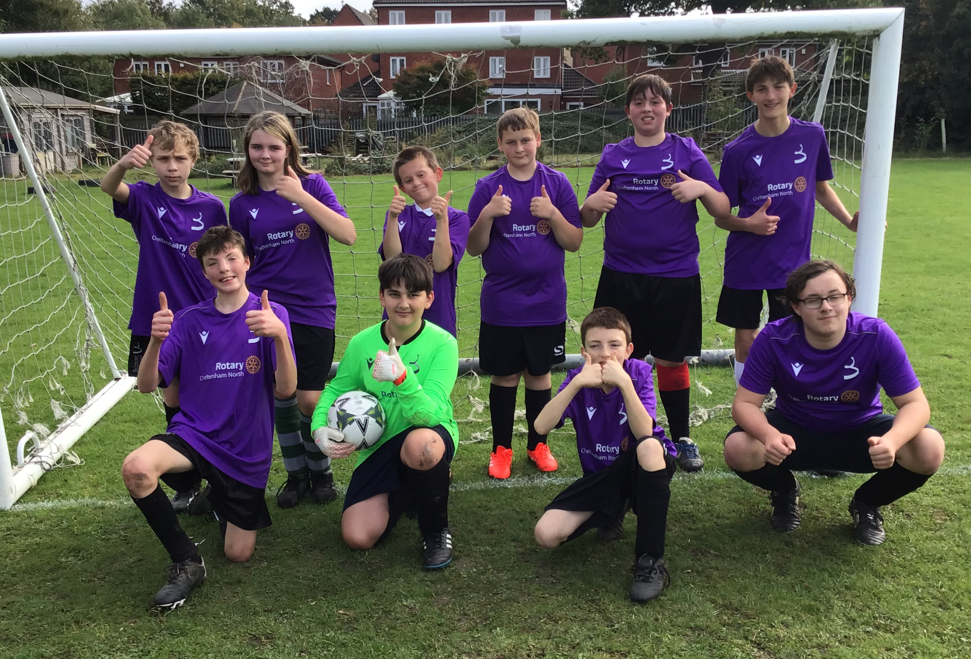
9th October 2024 - Our first school match of the 24/25 year. We welcomed Wotton House for a good competitive match.

Slide 2
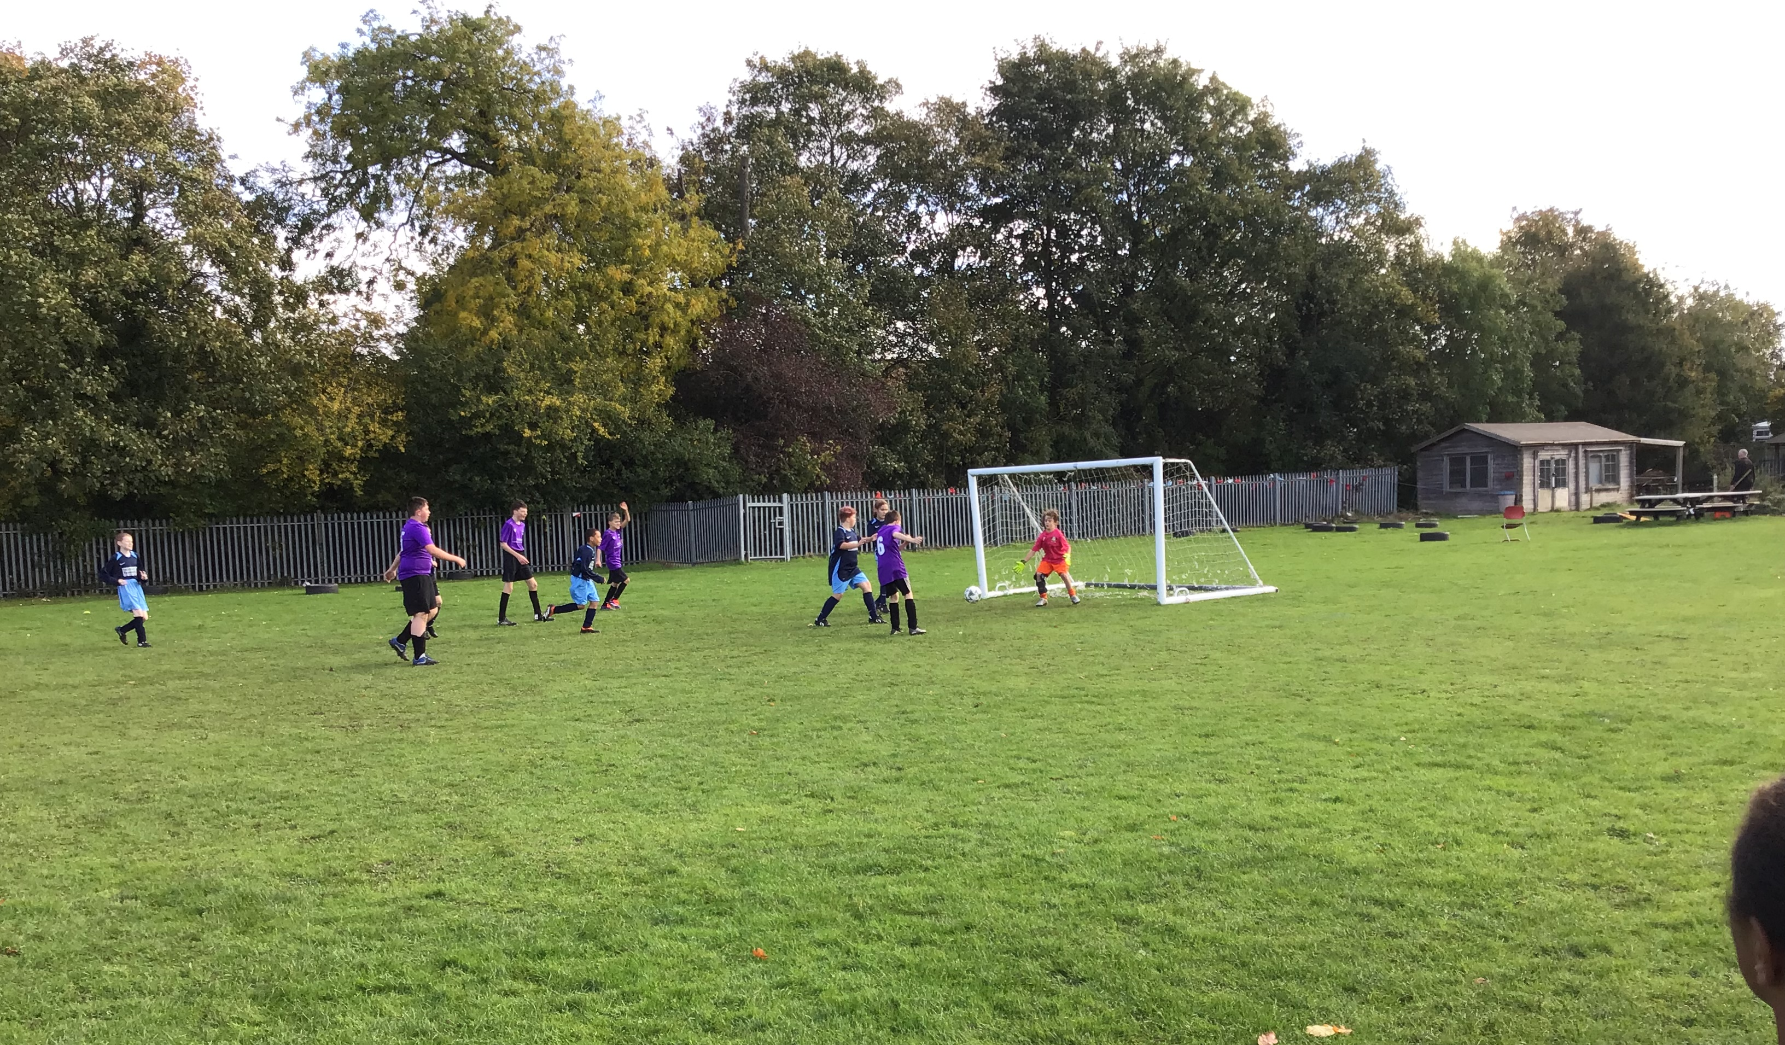
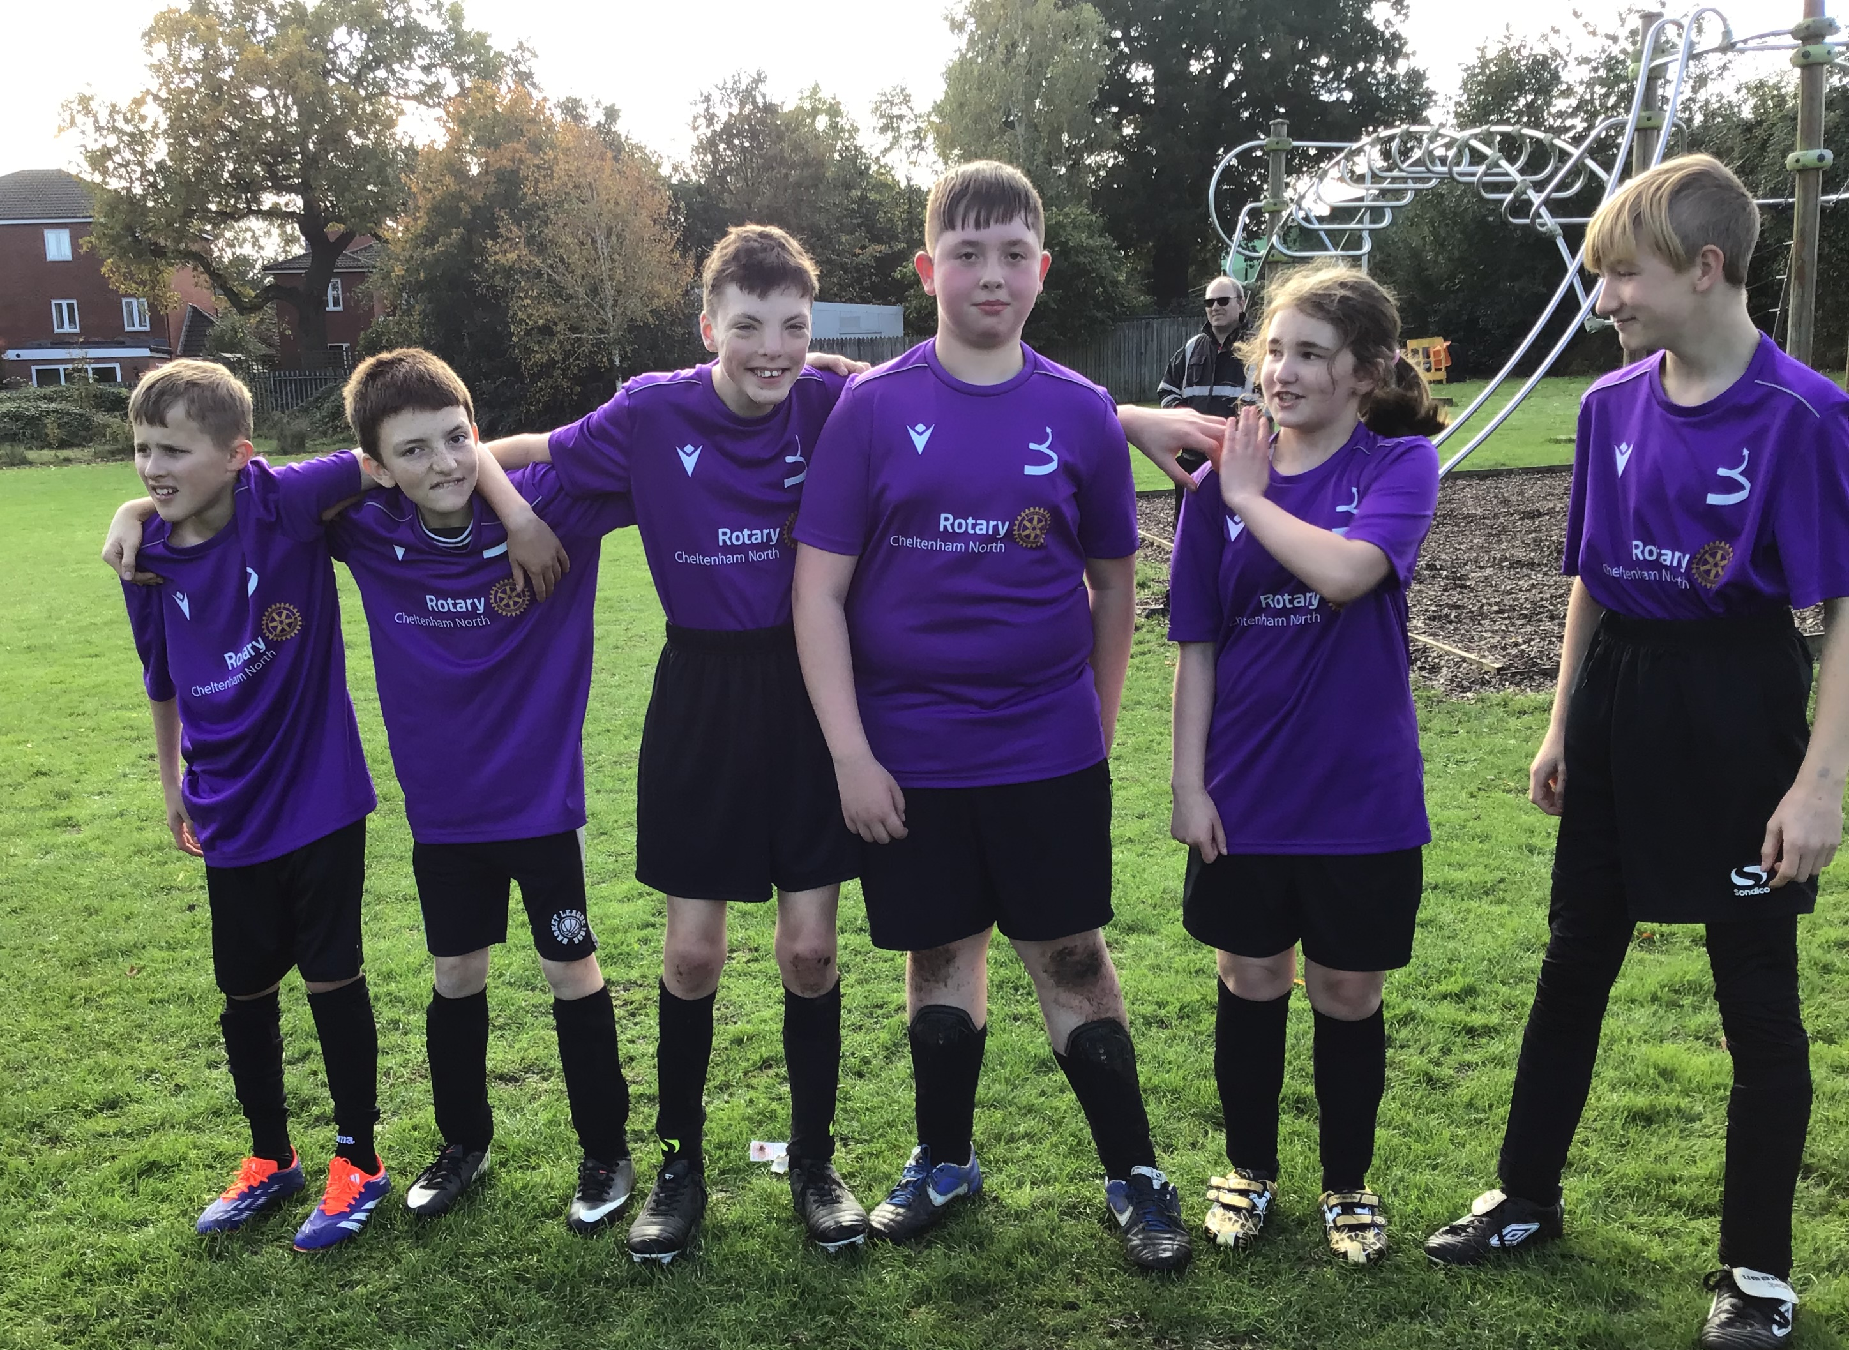
22nd October 2024 - The Belmont KS3 team took on Milestones in a close match all the way until the final whistle. Some great goal keeping and goals from both teams.
Ethan Wheeler (Captain) “We made positive comments to each and had a great game. We are proud that we scored 2 goals with our teamwork.”

