Slide 1
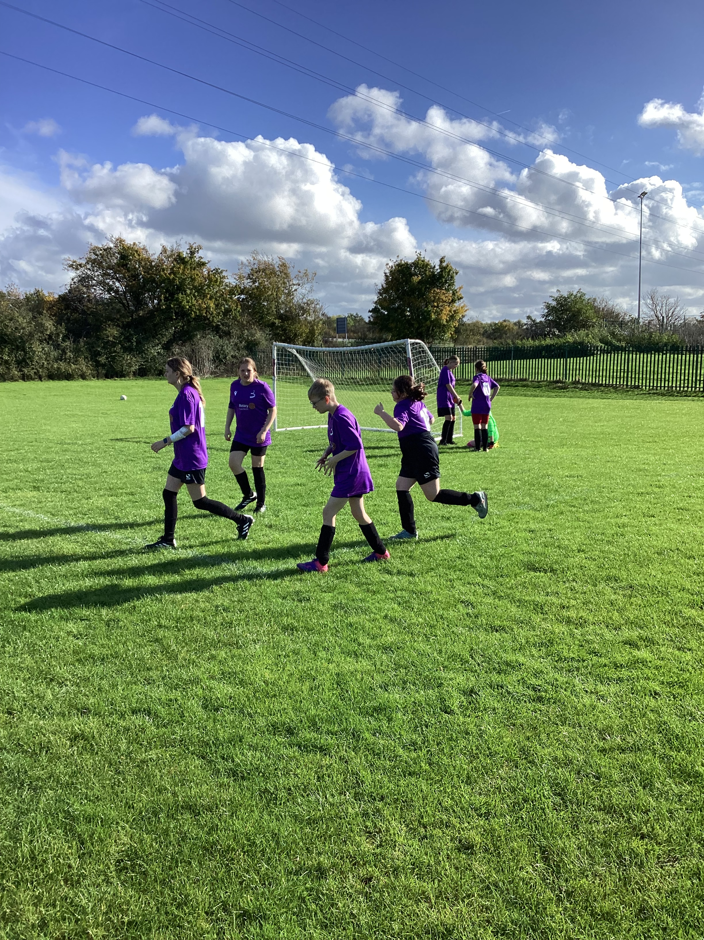
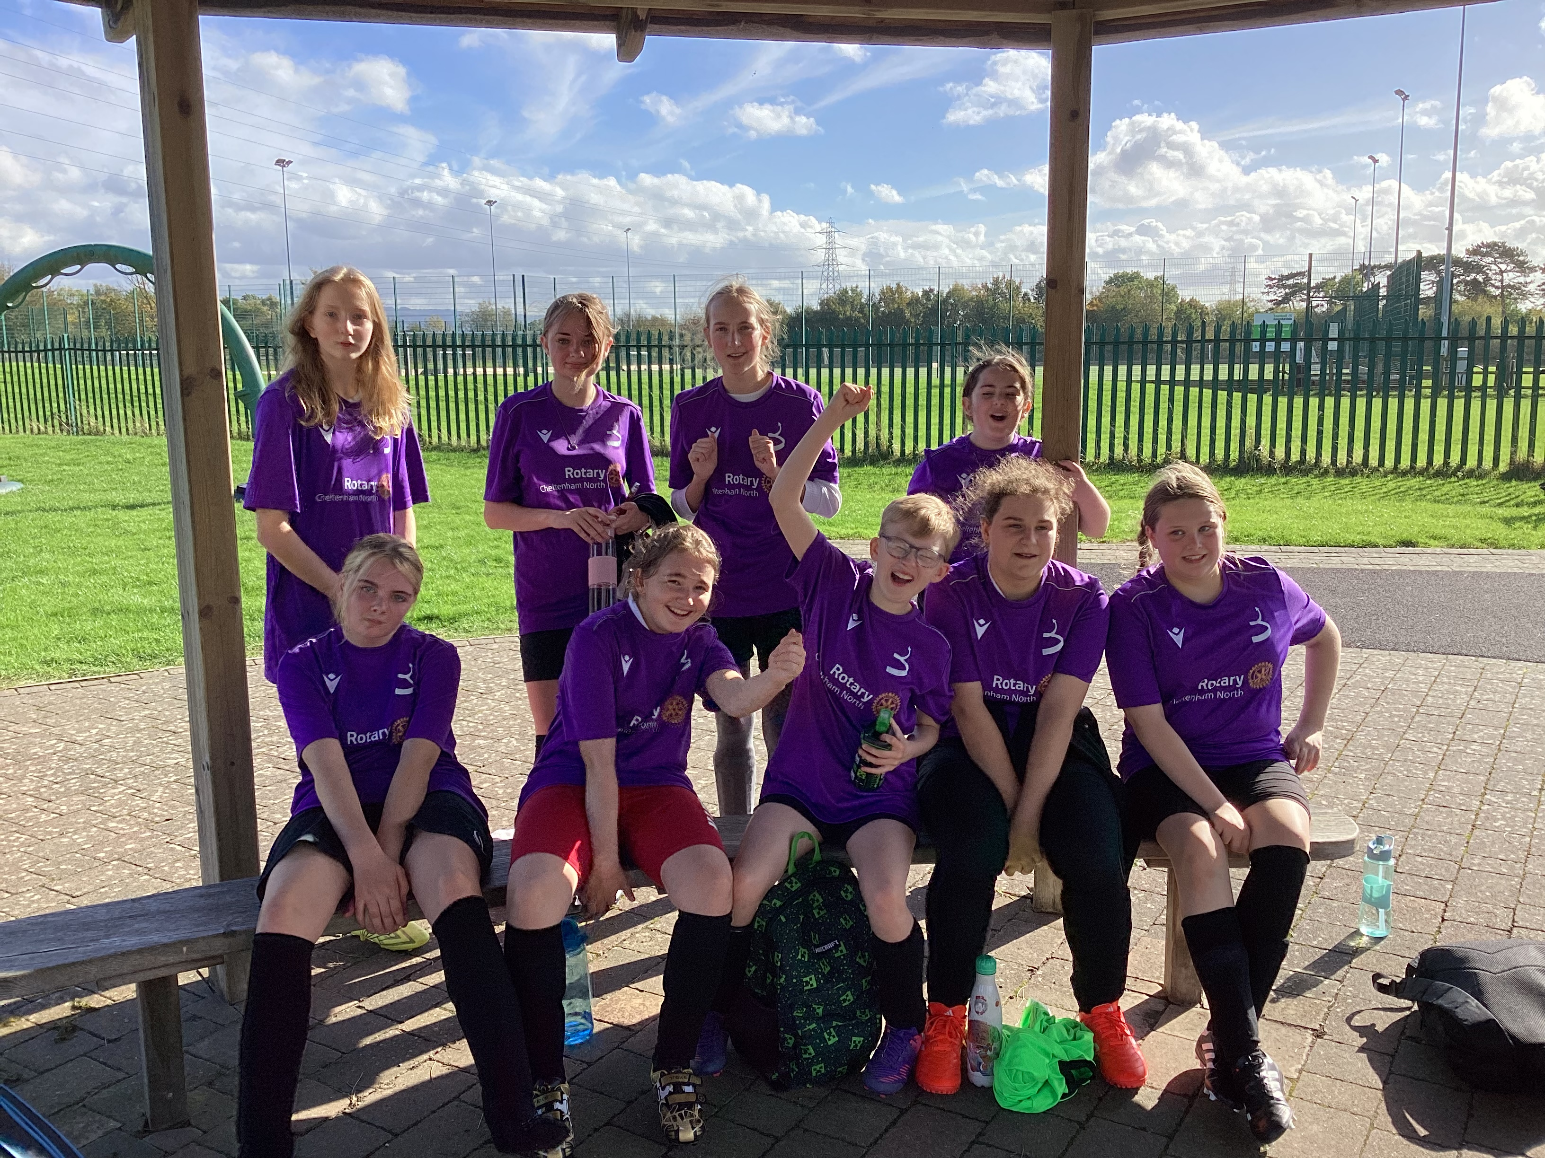
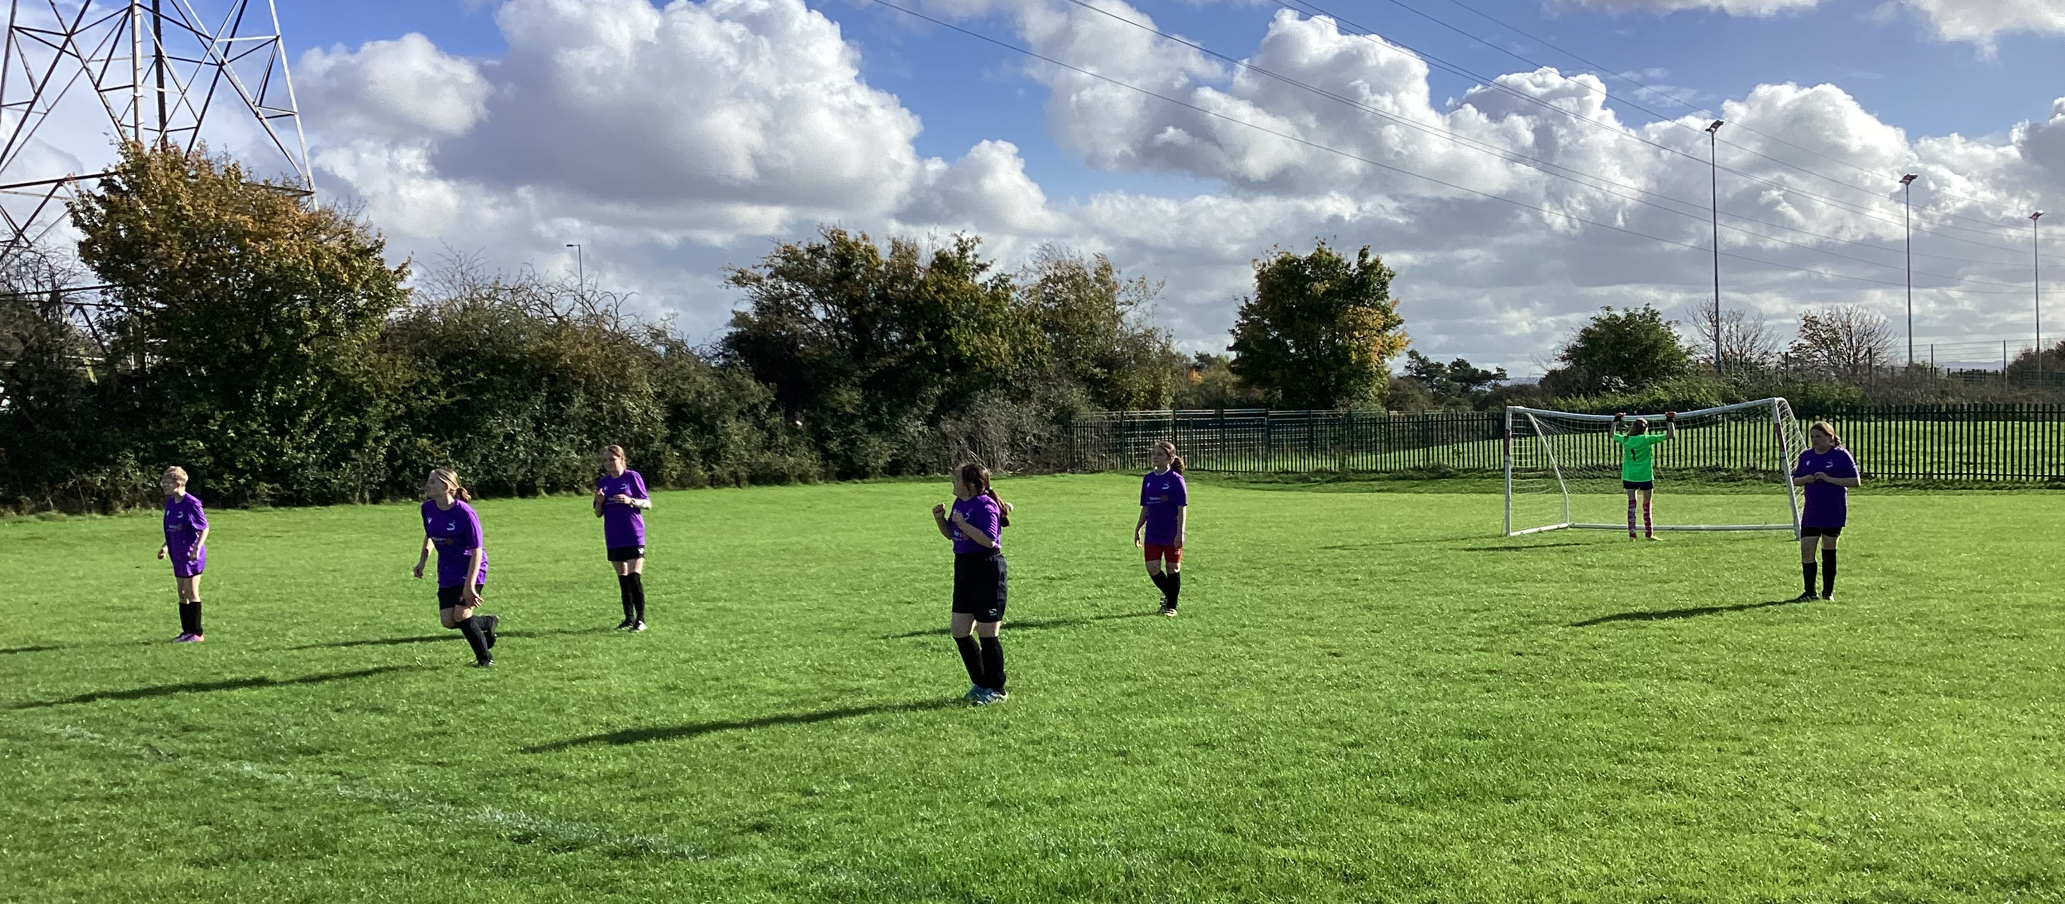
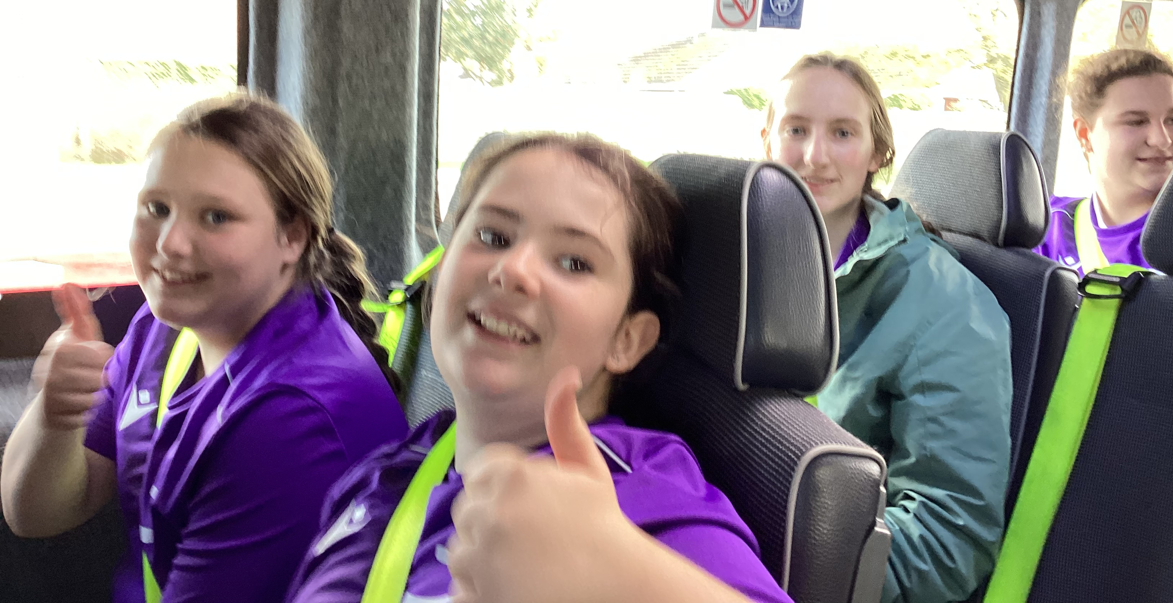
17th October 2024 - Our first ever girls only away fixture against Alderman Knight in Term 1. A great game with 2 really enthusiastic teams.
Team Captain Grace, ”It was the first time the girls went away for a football match. It was a very friendly match and the girls did really well. We ended up wining 6-1!”

